Slide 1


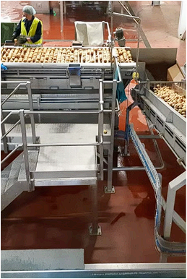

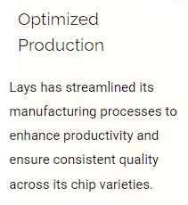

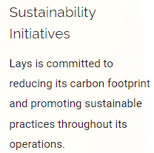
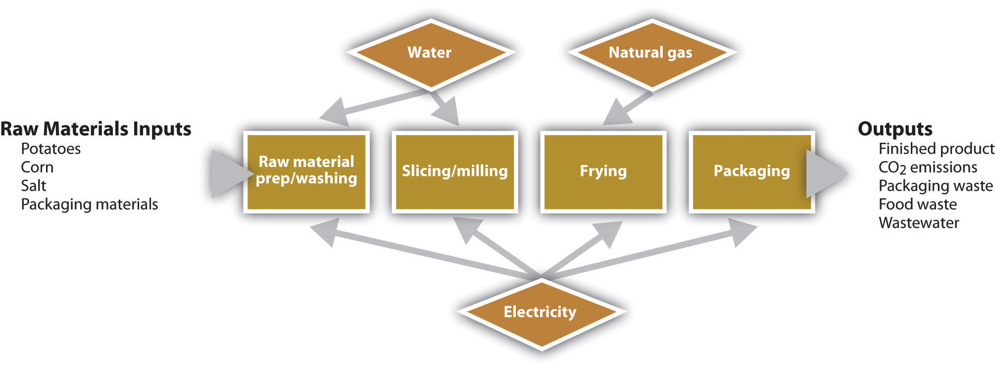


RV College of
Engineering
Lay’s : American Style Cream and Onion Flavours in India
Department of Biotechnology
RV College of Engineering, Bangalore – 560059, INDIA
Go, change the world
Introduction:
Lay's, a globally recognized brand of potato chips, is renowned for its diverse flavor offerings. Among these, the "American Style Cream & Onion" flavor is particularly popular in India. This report delves into the material analysis of this specific flavor, focusing on its composition, packaging, and regulatory compliance within the Indian market.
Objectives:
Analyse the Composition
2. Evaluate Packaging
3. Review Regulatory Compliance
Service Development of Lay’s
Lays is known for its innovative approach to product development, constantly exploring new flavours and formulations to delight its customers. The service development team works closely with R&D to identify emerging trends and translate them into exciting new chip offerings.
RAW MATERIALS:
Lay's, a flagship brand under PepsiCo, is a market leader in the Indian snack industry, renowned for its wide range of flavored potato chips.
Potatoes : Potatoes are the primary ingredient in Lay's chips, providing the base for the product.
Onion Powder : Onion powder is a key ingredient, providing the distinct onion flavor that defines this chip variety.
Cream Powder : Cream powder is essential for providing the creamy taste and texture that characterizes the "American Style Cream & Onion" flavor.
Vegetable Oils : Vegetable oils are used for frying the potato chips, contributing to their texture and flavor.
Spices and Condiments : Spices and condiments, including garlic powder, salt, and sugar, are used to enhance the overall flavor profile.
Operational Efficiency
PROCESS ANALYSIS:
Potato Sourcing and Preparation : Lay's sources high-quality potatoes from top growing regions, ensuring freshness and flavor.
Frying and Seasoning Process : The chips are fried to a golden crisp using carefully controlled methods.
Packaging and Distribution : The chips are packaged in airtight bags to preserve freshness. Lay’s distributes its products across India, making them accessible in grocery stores, shops, and vending machines.
Acknowledgements
The authors thank H RAJU, Department of Biotechnology, RVCE, for the kind support received for the completion of the project.
Team Information:
SANKALPA B R(1RV22CS178) PRATHEEK RAO(1RV22CS147)
NAGAPRASAD NAIK(1RV23CS410) MANOJ KUMAR B V(1RV23CS407)

